Slide 1
Capstone Walkthrough
24
MySQL
SQL Queries
18+
Pornimaa Eswari Ganesan
DB Tables
Data Analytics Capstone • MySQL Database Project
6
Topic Areas

Slide 2
Database Overview
Slide 2 of 28
A multi-domain MySQL database simulating a real-world financial services bank with customers, employees, branches, expenditures, loans, and transaction records.
💳 Customer Transactions
🏦 Branch & Geography
💰 Expenditures & Budget
Credit card transactions with amounts, merchant categories, payment methods, and fraud flags. Supports segmentation and risk analysis.
Physical branches organized by state and region with hub cities. Enables regional distribution and proximity analysis.
Departmental spending across fiscal years with vendors, cost centers, and budget categories for financial performance tracking.
👥 Employees & HR
📋 Loan Applications
🔍 Fraud Detection
Employee records with tenure, branch assignment, and department data supporting workforce analytics and reporting.
Loan pipeline with applicant credit history (Good/None), approval status, and amounts for credit outcome comparison.
Transaction-level fraud flags and merchant location data enabling fraud rate analysis and risk-level classification.
MySQL Capstone • Pornimaa Eswari Ganesan
2 / 28

Slide 3
Domain Information
Financial Services Banking — MySQL Capstone
Business Domain Context
Key SQL Techniques Used
Industry:
Retail Banking & Financial Services
1
SELECT + JOINs
Multi-table queries linking customers, transactions, branches
Entity:
Multi-regional bank with branch network
2
GROUP BY + HAVING
Aggregations with filters — vendor spend, dept totals
Customers:
Consumer credit card holders across US regions
3
ORDER BY + LIMIT
Top-N rankings — top 10 expenditures, customers
Geography:
Regions → States → Hub Cities → Branches
4
CASE Statements
Conditional classification — size bands, risk levels
Staff:
Employees tracked per branch with tenure history
5
Subqueries
Correlated subqueries for above-average comparisons
Finance:
Departmental expenditure management (FY2024–2025)
6
Window Functions
Advanced analytics and running calculations
Lending:
Loan applications with credit history classification
7
Aggregate Functions
COUNT, SUM, AVG, MAX across financial domains
Fraud:
Transaction fraud detection & merchant risk profiling
8
Fraud Detection Logic
Flag-based fraud analysis by merchant and channel
MySQL Capstone • Pornimaa Eswari Ganesan
3 / 28

Slide 4
Schema Design & Data Modelling
Slide 4 of 28
Entity-Relationship model showing primary/foreign key relationships across all core tables
CUSTOMERS
TRANSACTIONS
EXPENDITURES
BRANCHES
EMPLOYEES
🔑 Customer_ID
🔑 Transaction_ID
🔑 Expense_ID
🔑 Branch_ID
🔑 Employee_ID
Customer_Name
🔗 Customer_ID (FK)
Vendor
Branch_Name
Employee_Name
Region
Amount
Amount
State
🔗 Branch_ID (FK)
State
Transaction_Date
Fiscal_Year
🔗 Region_ID (FK)
🔗 Department_ID (FK)
City
Merchant_Category
🔗 Department_ID (FK)
Hub_City
Hire_Date
Email
Payment_Method
🔗 Branch_ID (FK)
Position
Phone
Is_Fraud
Budget_Category
→ Transactions (1:M)
→ Employees (1:M)
→ LoanApplications (1:M)
→ Expenditures (1:M)
REGIONS
DEPARTMENTS
LOAN_APPLICATIONS
🔑 Region_ID
🔑 Department_ID
🔑 App_ID
Region_Name
Dept_Name
Customer_ID (FK)
Hub_City
Cost_Center
Loan_Amount
State_Count
Budget
Credit_History
Approved
MySQL Capstone • Pornimaa Eswari Ganesan
4 / 28

Slide 5
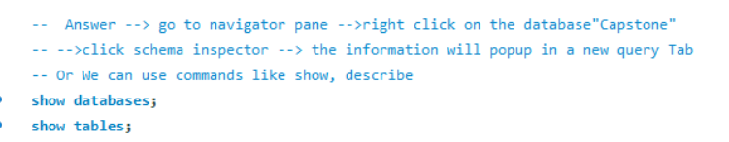
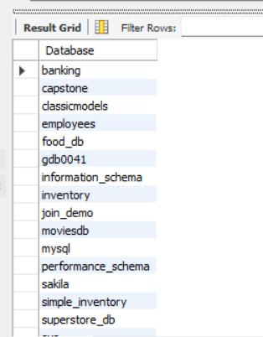
Q1
Database Structure
SQL Query
Result Set
MySQL Capstone • Pornimaa Eswari Ganesan
5 / 28

Slide 6
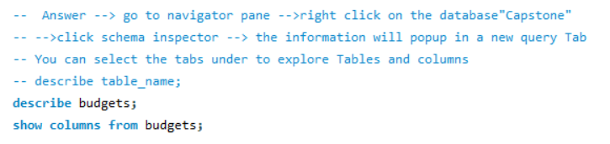
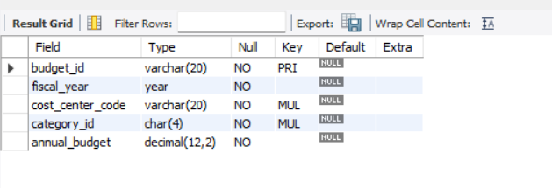
Q2
Table Structure / Column Information
SQL Query
Result Set
MySQL Capstone • Pornimaa Eswari Ganesan
6 / 28

Slide 7
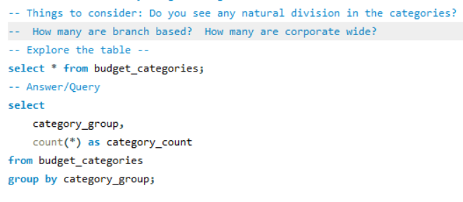
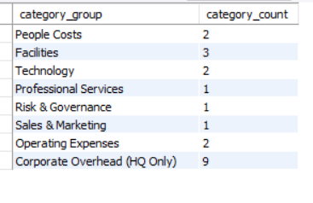
Q3
How many budget categories are there?
SQL Query
Result Set
MySQL Capstone • Pornimaa Eswari Ganesan
7 / 28

Slide 8
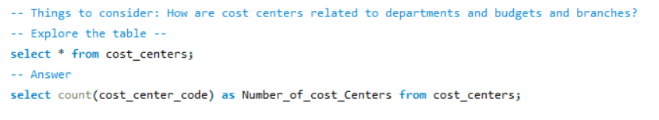
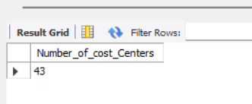
Q4
How many cost centers are there?
SQL Query
Result Set
MySQL Capstone • Pornimaa Eswari Ganesan
8 / 28

Slide 9
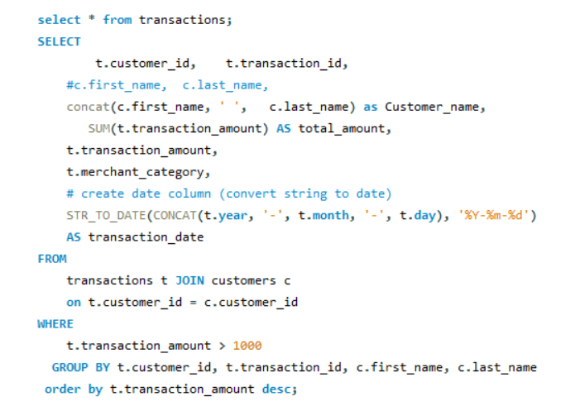
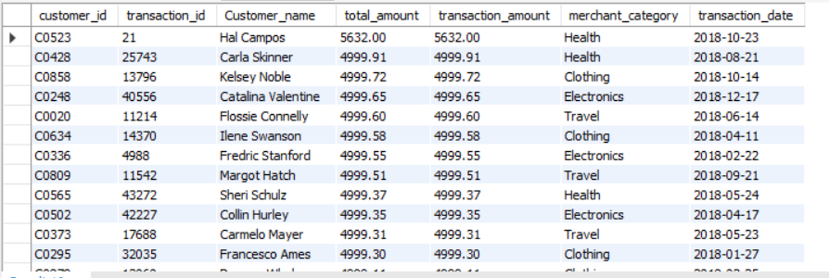
Q5
List all customer transactions over $1,000
SQL Query
Result Set
MySQL Capstone • Pornimaa Eswari Ganesan
9 / 28

Slide 10
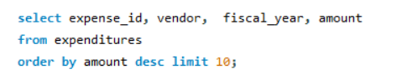
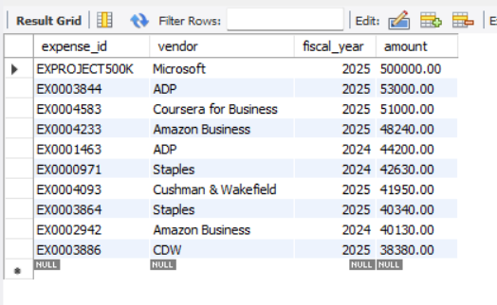
Q6
Find the top 10 highest expenditures by amount
SQL Query
Result Set
MySQL Capstone • Pornimaa Eswari Ganesan
10 / 28

Slide 11
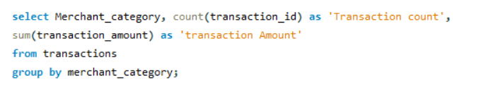
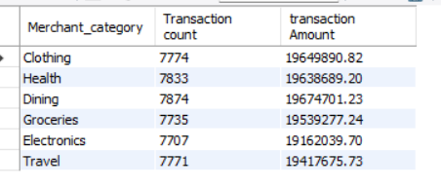
Q7
Total customer transaction amount and count by merchant category
SQL Query
Result Set
MySQL Capstone • Pornimaa Eswari Ganesan
11 / 28

Slide 12
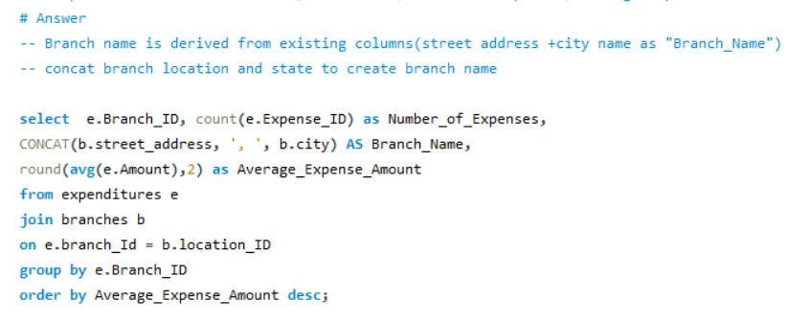
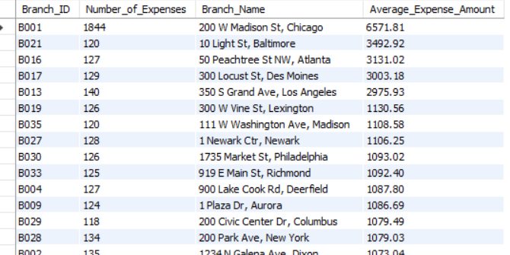
Q8
Average expenditure amount per branch
SQL Query
Result Set
MySQL Capstone • Pornimaa Eswari Ganesan
12 / 28

Slide 13
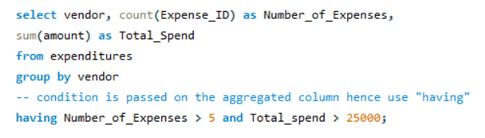
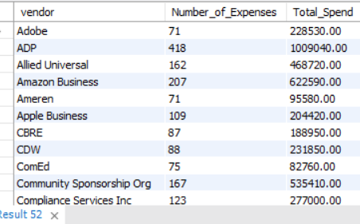
Q9
Expenditure vendors with >5 expenses and >$25,000 total spend
SQL Query
Result Set
MySQL Capstone • Pornimaa Eswari Ganesan
13 / 28

Slide 14
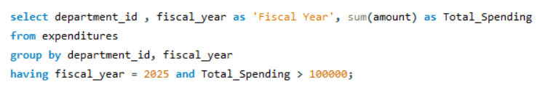
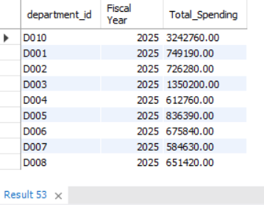
Q10
Departments with 2025 total spending exceeding $100,000
SQL Query
Result Set
MySQL Capstone • Pornimaa Eswari Ganesan
14 / 28

Slide 15
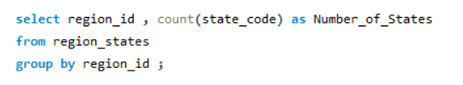
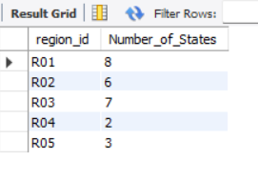
Q11
How many states per region?
SQL Query
Result Set
MySQL Capstone • Pornimaa Eswari Ganesan
15 / 28

Slide 16
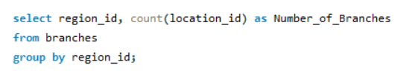
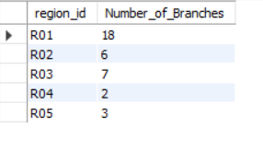
Q12
How many branches per region?
SQL Query
Result Set
MySQL Capstone • Pornimaa Eswari Ganesan
16 / 28

Slide 17
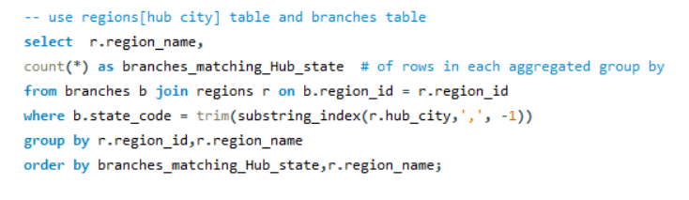
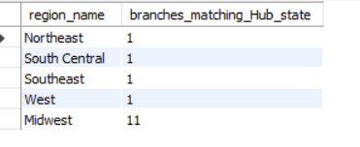
Q13
Branches in the same state as their region's hub city
SQL Query
Result Set
MySQL Capstone • Pornimaa Eswari Ganesan
17 / 28

Slide 18
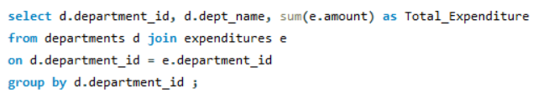
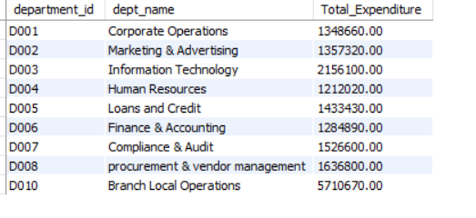
Q14
Total expenditure per department
SQL Query
Result Set
MySQL Capstone • Pornimaa Eswari Ganesan
18 / 28

Slide 19
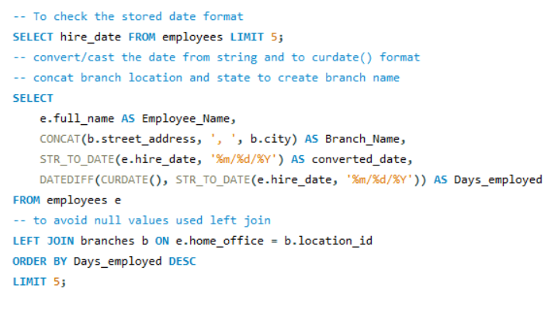
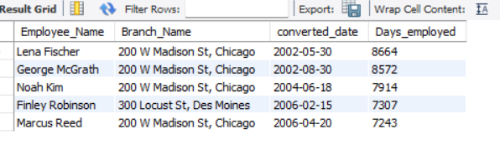
Q15
Top 5 employees with longest employment and branch
SQL Query
Result Set
MySQL Capstone • Pornimaa Eswari Ganesan
19 / 28

Slide 20
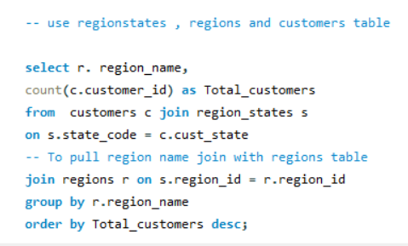
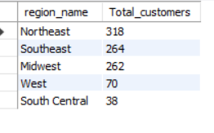
Q16
Customers per region — highest to lowest
SQL Query
Result Set
MySQL Capstone • Pornimaa Eswari Ganesan
20 / 28

Slide 21
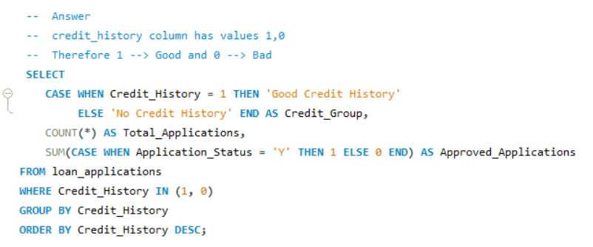
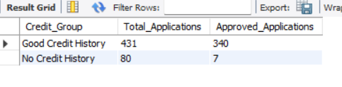
Q17
Loan applications: good credit vs. no credit history
SQL Query
Result Set
MySQL Capstone • Pornimaa Eswari Ganesan
21 / 28

Slide 22
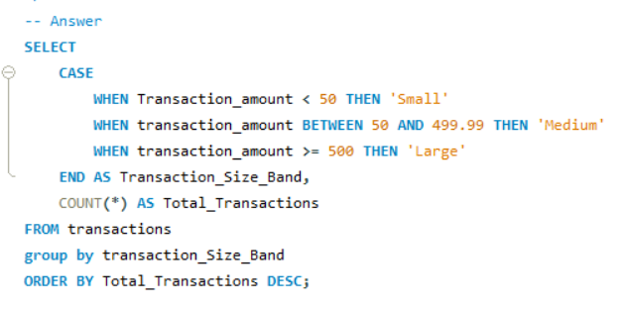
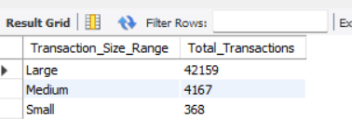
Q18
Classify customer transactions into size bands (CASE)
SQL Query
Result Set
MySQL Capstone • Pornimaa Eswari Ganesan
22 / 28

Slide 23
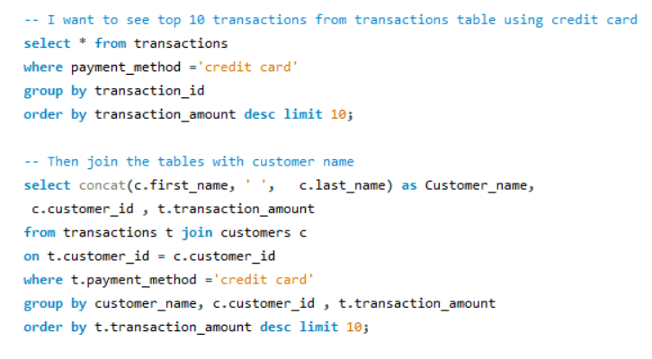
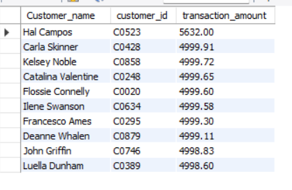
QA1
Top 10 customers by credit card transactions
SQL Query
Result Set
MySQL Capstone • Pornimaa Eswari Ganesan
23 / 28

Slide 24
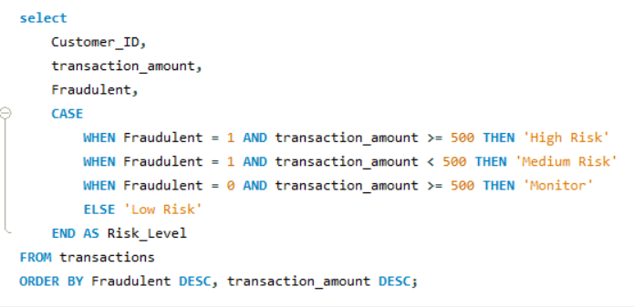
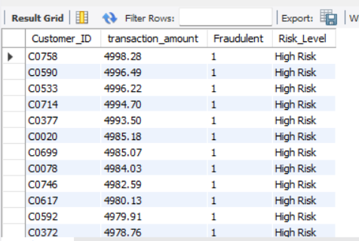
QA2
CASE: Flag transaction risk levels (high to low)
SQL Query
Result Set
MySQL Capstone • Pornimaa Eswari Ganesan
24 / 28

Slide 25
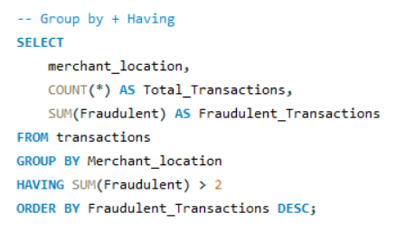
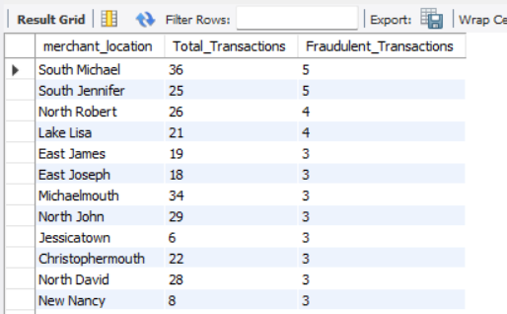
QA3
Merchant locations with >2 fraudulent transactions
SQL Query
Result Set
MySQL Capstone • Pornimaa Eswari Ganesan
25 / 28

Slide 26
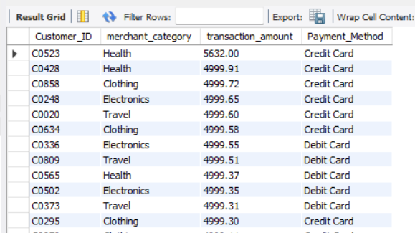
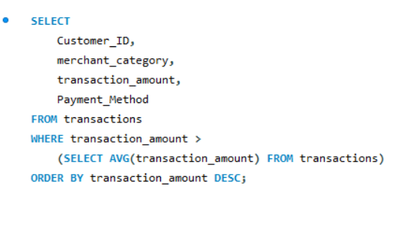
QA4
Customer transactions exceeding average — payment method
SQL Query
Result Set
MySQL Capstone • Pornimaa Eswari Ganesan
26 / 28

Slide 27
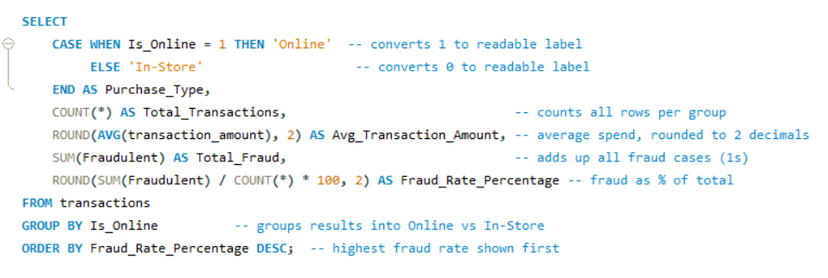
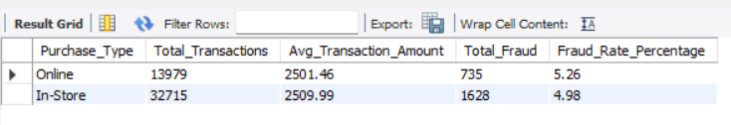
QA5
Fraud rate and avg transaction: online vs. in-store
SQL Query
Result Set
MySQL Capstone • Pornimaa Eswari Ganesan
27 / 28

Slide 28
Key Insights & Areas for Improvement
Slide 28 of 28
Based on the analysis across 24 SQL queries, the following insights and opportunities have been identified:
💡 Expenditure Concentration Risk
📊 Transaction Volume Imbalance
Finding: A small number of vendors account for disproportionately high spend (>$25K).
Finding: Merchant categories show uneven transaction distributions with some categories dominating volume.
Improve: Implement vendor spend caps and diversification policies to reduce single-vendor dependency.
Improve: Introduce category-level reporting dashboards and rebalance merchant partnerships.
🚨 Fraud Detection Gaps
🏢 Branch-Level Spending Variance
Finding: Certain merchant locations are flagged for multiple fraudulent transactions indicating geographic hot spots.
Finding: Average expenditure per branch varies significantly — some branches spend well above the mean.
Improve: Deploy real-time merchant-level fraud scoring and flag high-risk locations for enhanced review.
Improve: Set branch-level budget targets with quarterly reviews. High-spend branches should require additional approval layers.
📋 Credit History & Loan Approvals
👥 Employee Tenure & Retention
Finding: Applicants with no credit history face significantly lower approval rates than those with good credit.
Finding: Top 5 longest-tenured employees are concentrated in specific branches — potential knowledge silo risk.
Improve: Develop alternative credit scoring models using transaction history to serve thin-file customers.
Improve: Implement cross-branch mentorship programs and succession planning to distribute institutional knowledge.
MySQL Capstone • Pornimaa Eswari Ganesan
28 / 28

